Slide 1
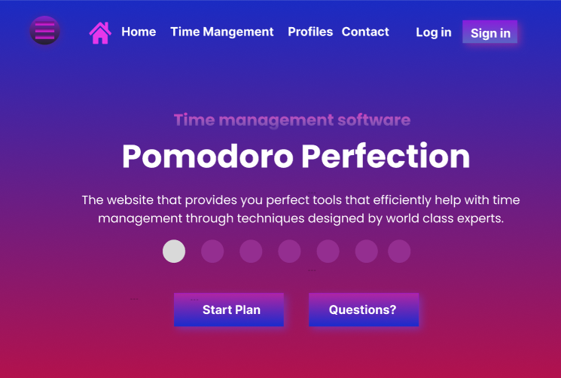
The three line icon shows all the options for users to click on and will be incorporated in smaller devices
Time management help techniques and customised for user
Profiles of all developers with drop down linking to each one
The sign in button is made to stand out to users and help people to sign up
The home icon will refresh the landing page and it is also useful as it breaks down language barriers to those that aren’t fluent in English
The blue gives the background a nice aesthetic touch, whilst simultaneously, blue is a colour that is accessible and friendly to those that are colour blind
This is a slide show that displays useful information to the user with text prompts to help
Possible name of the company
When the user clicks on this button, it will direct the users to specific pages that will fill in their details and generate a custom plan tailored to the users to help them with time management
The questions button is similar to contact as it takes users to a contact forum for them to ask questions

Slide 2
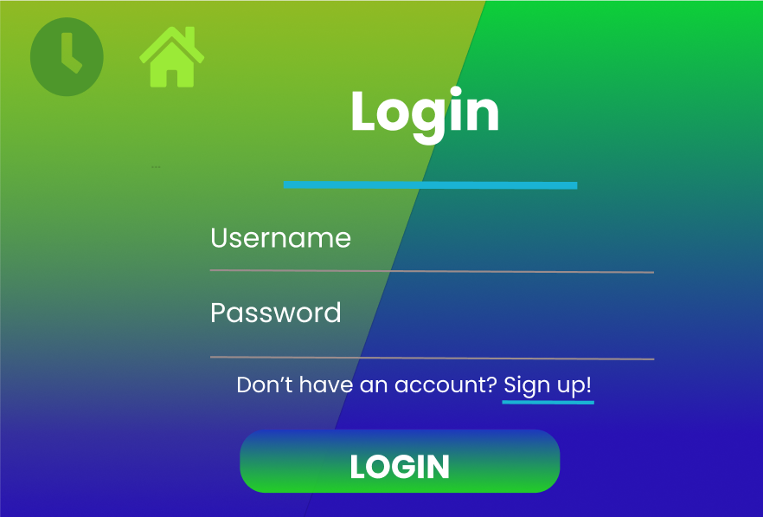
The house Icon will automatically direct users back to the main page
Like all pages, the main heading/title of the page has been placed at the top to distinguish the many various pages
The time icon and the green colour scheme metaphorically represent time which is the purpose of the website
The user name field allows users to type in their username
If the user does not have an existing account detected, they will be directed to a sign in page
The password field allows users to type in their password
When the user has inputted their login details, they click on login which will log them into their account providing their information is correct

